Slide 1





AI – ML VIRTUAL INTERSHIP REVIEW
Submitted By:-
VARUN SAINI
22SCSE1280051
B.Tech in AI & DS

Slide 2
INTRODUCTION
AI – ML VIRTUAL INTERSHIP REVIEW

Slide 3
Duration 10 weeks.
Provides hand-on experience with cutting edge technologies.
Opportunity to work with:
-TensorFlow
-Numpy
-Keras
-Google Cloud AI
-Colab
INTRODUCTION
AI – ML VIRTUAL INTERSHIP REVIEW

Slide 4
Duration 6 weeks.
Provides hand-on experience with cutting edge technologies.
Opportunity to work with:
-TensorFlow
-Numpy
-Keras
INTRODUCTION
AI – ML VIRTUAL INTERSHIP REVIEW
6 learning Stages:
-Program Neural Network with Tensor flow
-Get Start with object detection
-Go further with object detection
-Get started with Product Image Search
-Go further with Product Image Search
-Go further with Image Classification

Slide 5

Duration 6 weeks.
Provides hand-on experience with cutting edge technologies.
Opportunity to work with:
-TensorFlow
-Numpy
-Keras
INTRODUCTION
AI – ML VIRTUAL INTERSHIP REVIEW
6 learning Stages:
-Program Neural Network with Tensor flow
-Get Start with object detection
-Go further with object detection
-Get started with Product Image Search
-Go further with Product Image Search
-Go further with Image Classification
KEY LEARNING
AND
SKILLS ACQUIRED

Slide 6
Duration 6 weeks.
Provides hand-on experience with cutting edge technologies.
Opportunity to work with:
-TensorFlow
-Numpy
-Keras
INTRODUCTION
AI – ML VIRTUAL INTERSHIP REVIEW
1
2
6 learning Stages:
-Program Neural Network with Tensor flow
-Get Start with object detection
-Go further with object detection
-Get started with Product Image Search
-Go further with Product Image Search
-Go further with Image Classification
WHAT IS MACHIME LEARNING (ML)?
TENSORFLOW AND KERAS
4
3
KEY LEARNING
AND
SKILLS ACQUIRED
COMPUTER VISION, OBJECT DETECTION, IMAGE DETECTION.
IMPLEMENTING NUMPY ON LARGE DATABASES
5
6
DATA PROCESSING AND ANALYSIS
Machine Learning Alogrithms
Supervised Learning
Unsupervised Learning

Slide 7

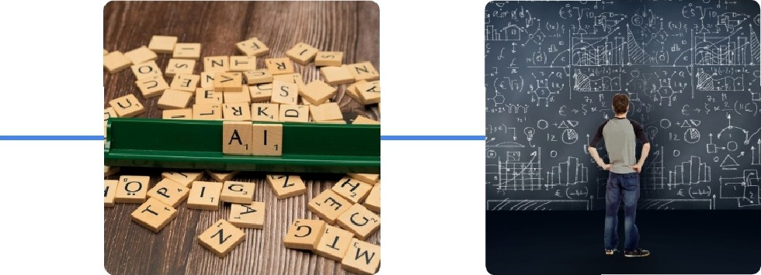
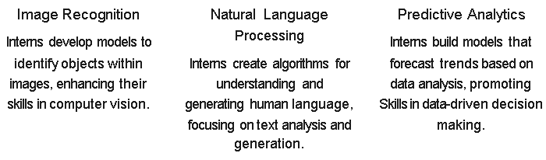

Duration 6 weeks.
Provides hand-on experience with cutting edge technologies.
Opportunity to work with:
-TensorFlow
-Numpy
-Keras
INTRODUCTION
AI – ML VIRTUAL INTERSHIP REVIEW
1
2
6 learning Stages:
-Program Neural Network with Tensor flow
-Get Start with object detection
-Go further with object detection
-Get started with Product Image Search
-Go further with Product Image Search
-Go further with Image Classification
WHAT IS MACHIME LEARNING (ML)?
TENSORFLOW AND KERAS
4
3
KEY LEARNING
AND
SKILLS ACQUIRED
COMPUTER VISION, OBJECT DETECTION, IMAGE DETECTION.
IMPLEMENTING NUMPY ON LARGE DATABASES
5
6
DATA PROCESSING AND ANALYSIS
Machine Learning Alogrithms
Supervised Learning
Unsupervised Learning
Hands-On Projects and Assignments
Internship Projects Focusing on AI-ML Techniques

Slide 8





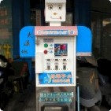

Duration 6 weeks.
Provides hand-on experience with cutting edge technologies.
Opportunity to work with:
-TensorFlow
-Numpy
-Keras
INTRODUCTION
AI – ML VIRTUAL INTERSHIP REVIEW
1
2
6 learning Stages:
-Program Neural Network with Tensor flow
-Get Start with object detection
-Go further with object detection
-Get started with Product Image Search
-Go further with Product Image Search
-Go further with Image Classification
WHAT IS MACHIME LEARNING (ML)?
TENSORFLOW AND KERAS
4
3
KEY LEARNING
AND
SKILLS ACQUIRED
COMPUTER VISION, OBJECT DETECTION, IMAGE DETECTION.
IMPLEMENTING NUMPY ON LARGE DATABASES
5
6
DATA PROCESSING AND ANALYSIS
Machine Learning Alogrithms
Supervised Learning
Unsupervised Learning
Career Opportunities Post- Internship
Hands-On Projects and Assignments
Internship Projects Focusing on AI-ML Techniques
Explore diverse career paths in AI and ML after your internship
AI Research Scientist
Engage in cutting-edge research in artificial intelligence and machine learning.
•••••
Data Scientist
Analyze and interpret intricate data sets to inform decision-
Machine Learning Engineer
Design and implement machine learning models for various applications.

Slide 9
Duration 6 weeks.
Provides hand-on experience with cutting edge technologies.
Opportunity to work with:
-TensorFlow
-Numpy
-Keras
INTRODUCTION
AI – ML VIRTUAL INTERSHIP REVIEW
1
2
6 learning Stages:
-Program Neural Network with Tensor flow
-Get Start with object detection
-Go further with object detection
-Get started with Product Image Search
-Go further with Product Image Search
-Go further with Image Classification
WHAT IS MACHIME LEARNING (ML)?
TENSORFLOW AND KERAS
4
3
KEY LEARNING
AND
SKILLS ACQUIRED
COMPUTER VISION, OBJECT DETECTION, IMAGE DETECTION.
IMPLEMENTING NUMPY ON LARGE DATABASES
5
6
DATA PROCESSING AND ANALYSIS
Machine Learning Alogrithms
Supervised Learning
Unsupervised Learning
Career Opportunities Post- Internship
Tools and Technologies Used
Interns gain hands-on experience with essential Google tools for AI-ML development.
Hands-On Projects and Assignments
Internship Projects Focusing on AI-ML Techniques
Explore diverse career paths in AI and ML after your internship
AI Research Scientist
Engage in cutting-edge research in artificial intelligence and machine learning.
Google Cloud AI
Provides cloud-based Al services and infrastructure for scalable solutions.
TensorFlow
An open-source platform that facilitates machine learning applications.
•••••
Data Scientist
Analyze and interpret intricate data sets to inform decision-
Colab
A free Jupyter notebook environment that allows for cloud-based coding.
Machine Learning Engineer
Design and implement machine learning models for various applications.
BigQuery
A fully-managed data warehouse designed for large-scale data analysis tasks.

Slide 10
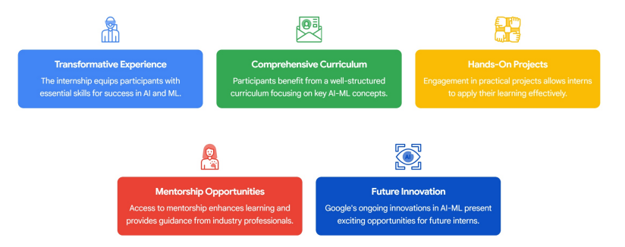
Duration 6 weeks.
Provides hand-on experience with cutting edge technologies.
Opportunity to work with:
-TensorFlow
-Numpy
-Keras
INTRODUCTION
AI – ML VIRTUAL INTERSHIP REVIEW
1
2
6 learning Stages:
-Program Neural Network with Tensor flow
-Get Start with object detection
-Go further with object detection
-Get started with Product Image Search
-Go further with Product Image Search
-Go further with Image Classification
WHAT IS MACHIME LEARNING (ML)?
TENSORFLOW AND KERAS
4
3
KEY LEARNING
AND
SKILLS ACQUIRED
COMPUTER VISION, OBJECT DETECTION, IMAGE DETECTION.
IMPLEMENTING NUMPY ON LARGE DATABASES
5
6
DATA PROCESSING AND ANALYSIS
Machine Learning Alogrithms
Supervised Learning
Unsupervised Learning
Tools and Technologies Used
Conclusion and Future Prospects
Exploring Opportunities in AI-ML Internship
Career Opportunities Post- Internship
Interns gain hands-on experience with essential Google tools for AI-ML development.
Hands-On Projects and Assignments
Internship Projects Focusing on AI-ML Techniques
Explore diverse career paths in AI and ML after your internship
AI Research Scientist
Engage in cutting-edge research in artificial intelligence and machine learning.
Google Cloud AI
Provides cloud-based Al services and infrastructure for scalable solutions.
TensorFlow
An open-source platform that facilitates machine learning applications.
•••••
Data Scientist
Analyze and interpret intricate data sets to inform decision-
Colab
A free Jupyter notebook environment that allows for cloud-based coding.
Machine Learning Engineer
Design and implement machine learning models for various applications.
BigQuery
A fully-managed data warehouse designed for large-scale data analysis tasks.

Slide 11
Duration 6 weeks.
Provides hand-on experience with cutting edge technologies.
Opportunity to work with:
-TensorFlow
-Numpy
-Keras
INTRODUCTION
AI – ML VIRTUAL INTERSHIP REVIEW
1
2
6 learning Stages:
-Program Neural Network with Tensor flow
-Get Start with object detection
-Go further with object detection
-Get started with Product Image Search
-Go further with Product Image Search
-Go further with Image Classification
WHAT IS MACHIME LEARNING (ML)?
TENSORFLOW AND KERAS
THANK YOU!
4
3
KEY LEARNING
AND
SKILLS ACQUIRED
COMPUTER VISION, OBJECT DETECTION, IMAGE DETECTION.
IMPLEMENTING NUMPY ON LARGE DATABASES
AI – ML VIRTUAL INTERSHIP
5
6
DATA PROCESSING AND ANALYSIS
Machine Learning Alogrithms
Supervised Learning
Unsupervised Learning
Unlock new potential and opportunities in technology with this internship.
Tools and Technologies Used
Conclusion and Future Prospects
Exploring Opportunities in AI-ML Internship
Career Opportunities Post- Internship
Interns gain hands-on experience with essential Google tools for AI-ML development.
Hands-On Projects and Assignments
Internship Projects Focusing on AI-ML Techniques
Explore diverse career paths in AI and ML after your internship
AI Research Scientist
Engage in cutting-edge research in artificial intelligence and machine learning.
Google Cloud AI
Provides cloud-based Al services and infrastructure for scalable solutions.
TensorFlow
An open-source platform that facilitates machine learning applications.
•••••
Data Scientist
Analyze and interpret intricate data sets to inform decision-
Colab
A free Jupyter notebook environment that allows for cloud-based coding.
Machine Learning Engineer
Design and implement machine learning models for various applications.
BigQuery
A fully-managed data warehouse designed for large-scale data analysis tasks.

